Slide 1
Challenges for control of vector borne diseases in an urban context
Dr. K. Ravi Kumar

Slide 2
What is the trend?

Slide 3
Trend..
In 2014 1.1 million total cases and 7.2 lakh P.f cases. (12.4 crore blood smears)
API =0.9, SPR=0.89, P.f % =65
In 2014 there has been a 25 % increase in total malaria cases and 55 % increase in P.f cases.
In 2015 also as on the end of May there is an increase of 6 % in total and 11 % in P.f cases.
356 deaths in 2015

Slide 4
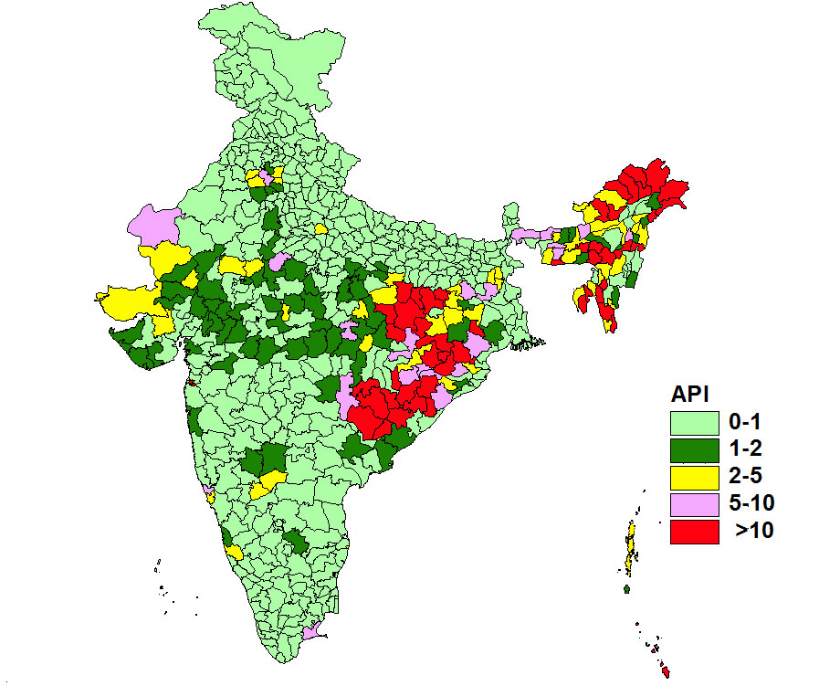
MALARIA ENDEMIC AREAS
PERCENTAGE CONTRIBUTION OF POPULATION, MALARIA CASES, PF CASES AND DEATHS (Compared to the country total)
States | % Population | % Malaria cases | % Pf cases | % Death
N.E. States | 4 | 13 | 17 | 46
Other high endemic states* | 42 | 67 | 77 | 43
Other | 54 | 20 | 6 | 11
API
*Andhra, Chhattisgarh, Gujarat, Jharkhand, MP,
Maharashtra, Orissa, Rajasthan
Notes:
4

Slide 5
Where is it prevalent more in 2014?

Slide 6
Where are the P.f cases in 2014

Slide 7
Urban or Rural ?
10 % of malaria cases from urban areas in the country
50 % in Karnataka

Slide 8
In Karnataka in 2014..
14,794 cases, 1329 P.f cases, only 2 deaths

Slide 9
In Karnataka, P.f cases in 2014..

Slide 10
Achievements
Moving towards elimination

Slide 11
What are the Challenges??? Technical..
Diagnosis and Monitoring
Unpredictable nature of development of complications.
Drug resistance
Co-infections and co-morbidities
Pregnancy
Vivax and complications; Relapses

Slide 12
What are the challenges in urban?
Poor infrastructure and low priority
Ineffectiveness of insecticidal residual spray and dependence only on antilarval measures
Single method has limitations and a combination of approaches is required.
Biocides
Insect growth regulators; Diflubenzeron
Variety of breeding places of anophelines

Slide 13
What are the challenges?
Construction activities:
Labourers
Increased breeding places
Adherence to national guidelines of treatment
Fake drugs
Governance issues
NUHM also has low priority for VBDs

Slide 14
Dengue and Chikungunya

Slide 15
Dengue in India
Year | 2008 | 2009 | 2010 | 2011 | 2012 | 2013 | 2014
Confirmed cases | 12561 | 15535 | 28292 | 18860 | 46902 | 75808 | 40425
Deaths | 80 | 96 | 110 | 169 | 241 | 193 | 131

Slide 16
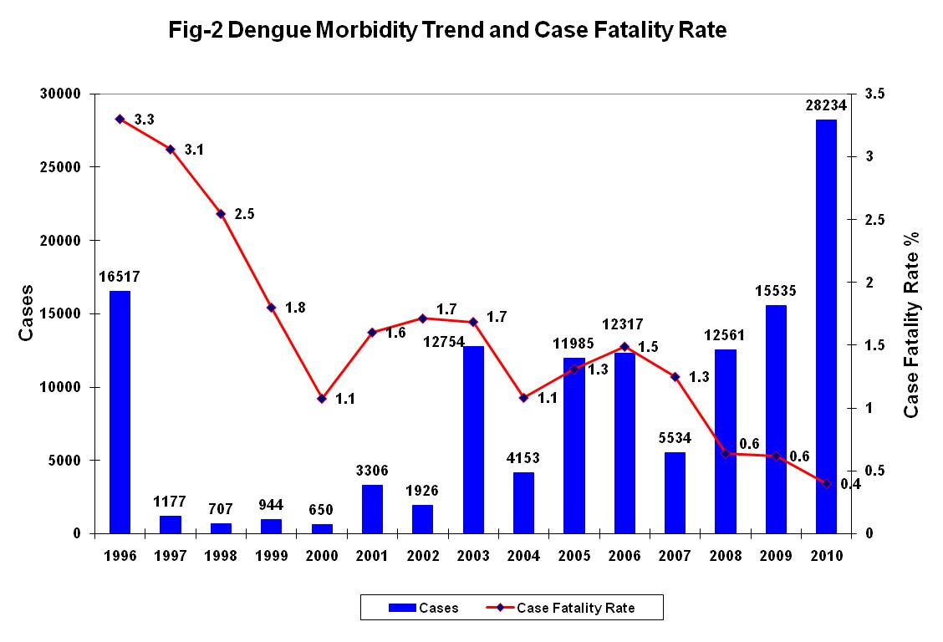

Slide 18
Dengue incidence 2014
Suspected Dengue fever cases 19696
Blood samples tested 11834
Confirmed cases 3066
ELISA 2732,
NS1 antigen 334

Slide 19
What about this year?
As on 26 Oct, 31408 suspected cases
4215 confirmed cases
9 deaths
Bengaluru, Bellary, and Udupi are worst affected

Slide 20
Chikungunya since 2006..

Slide 21
No Vaccine available as of now.
No specific treatment
Purely symptomatic
Non-salicylate analgesics and non-steroidal anti inflammatory drugs
Surveillance for early detection of outbreak
Vector Control
Adult vector measures
Anti-larval measures (Source reduction)
Personal protective measures
IEC
Notes:
21

Slide 22
Challenges..
Older age groups are being affected.
What previously is essentially an urban disease is increasingly being rural also.
Shortage of testing centers and diagnostic kits
Shortage of platelets ????
Poor knowledge and even poorer attitude regarding source reduction measures

Slide 23
Dengue vaccine ???

Slide 24
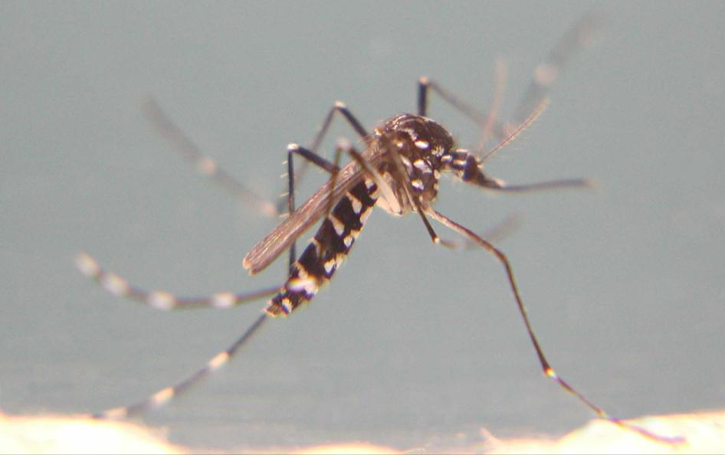
Aedes Mosquito

Slide 25
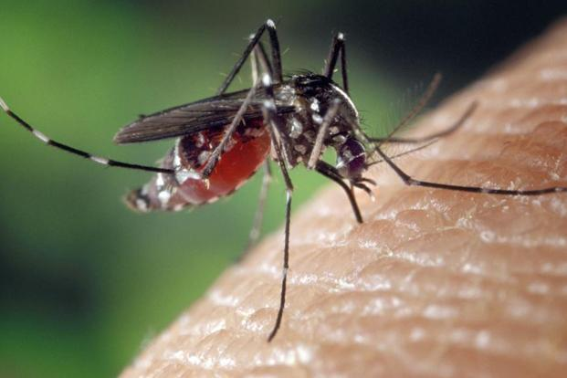

Slide 26
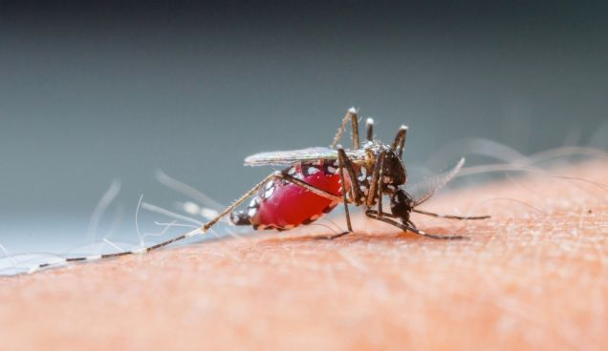

Slide 27
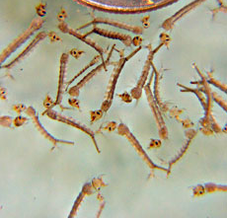
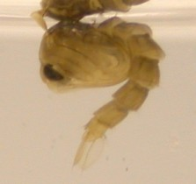
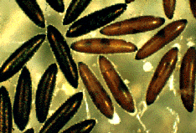
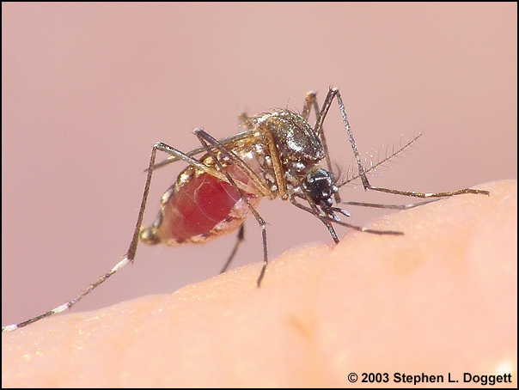
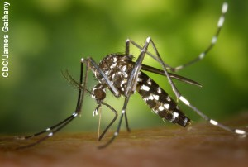

Slide 28
AEDES LARVAE

Slide 29
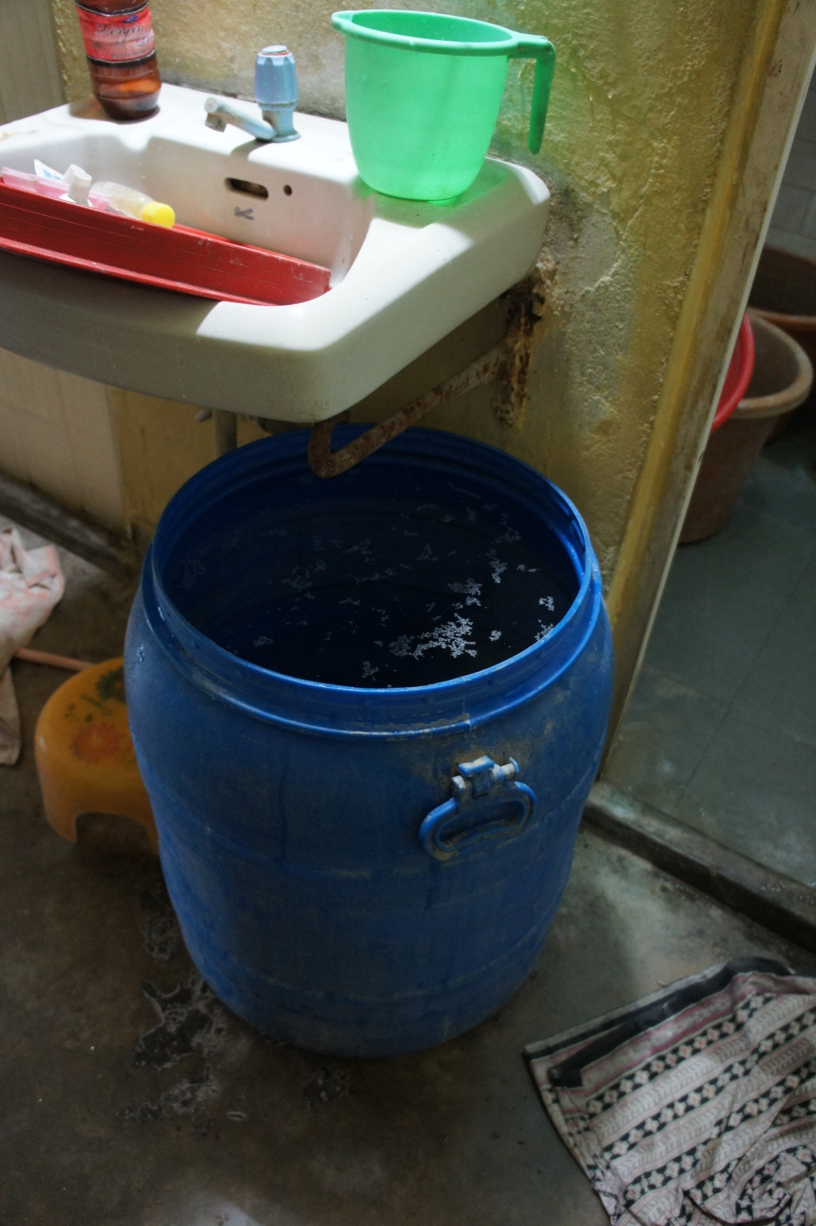

Slide 30
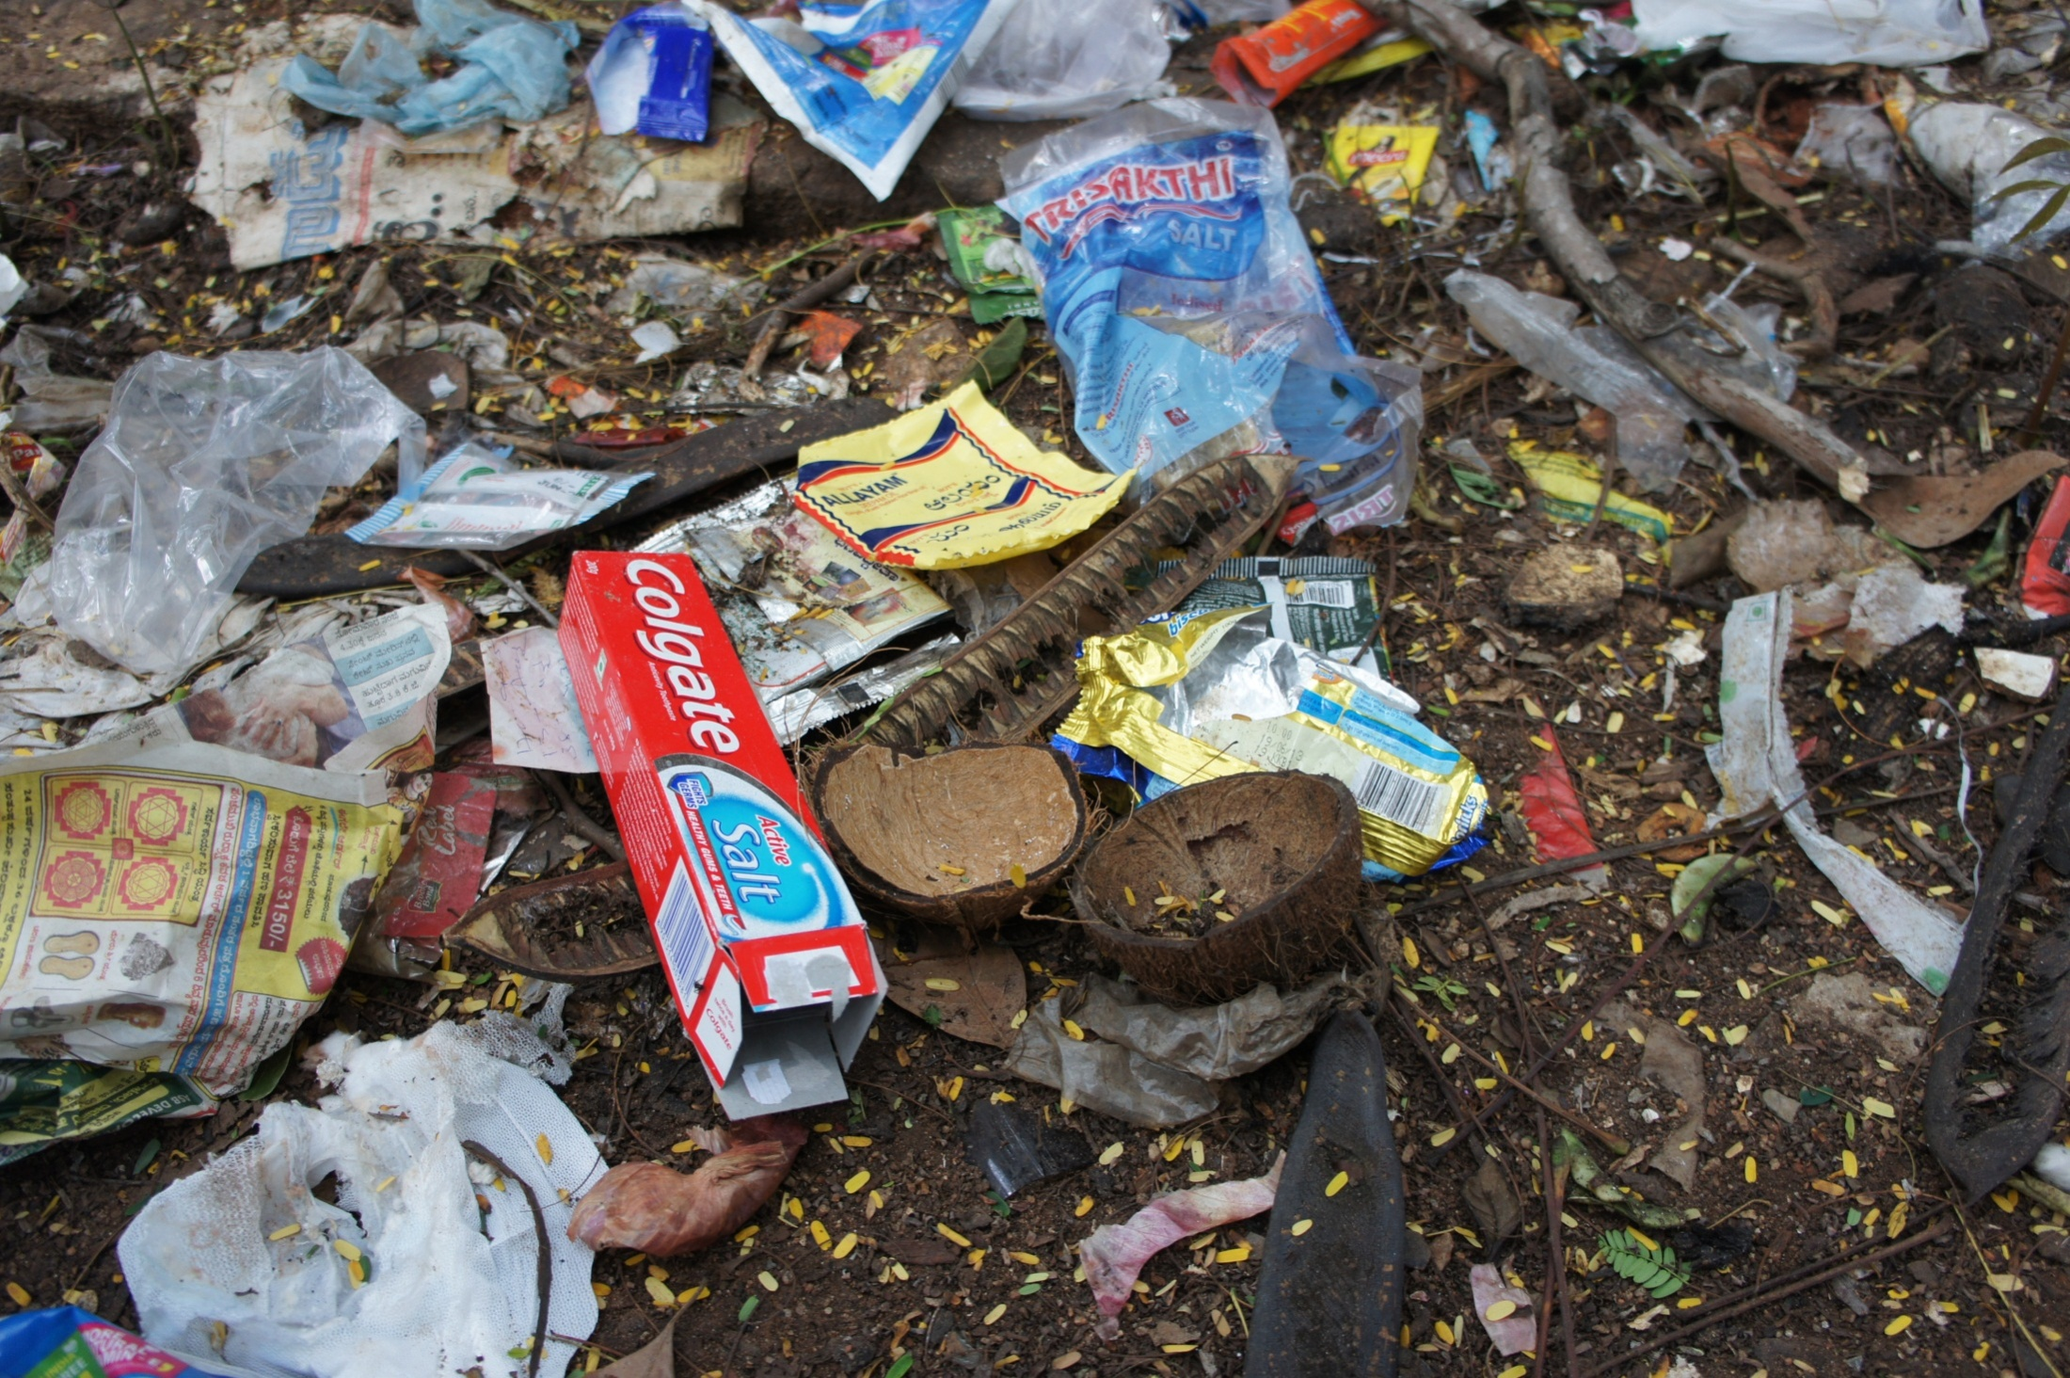

Slide 31
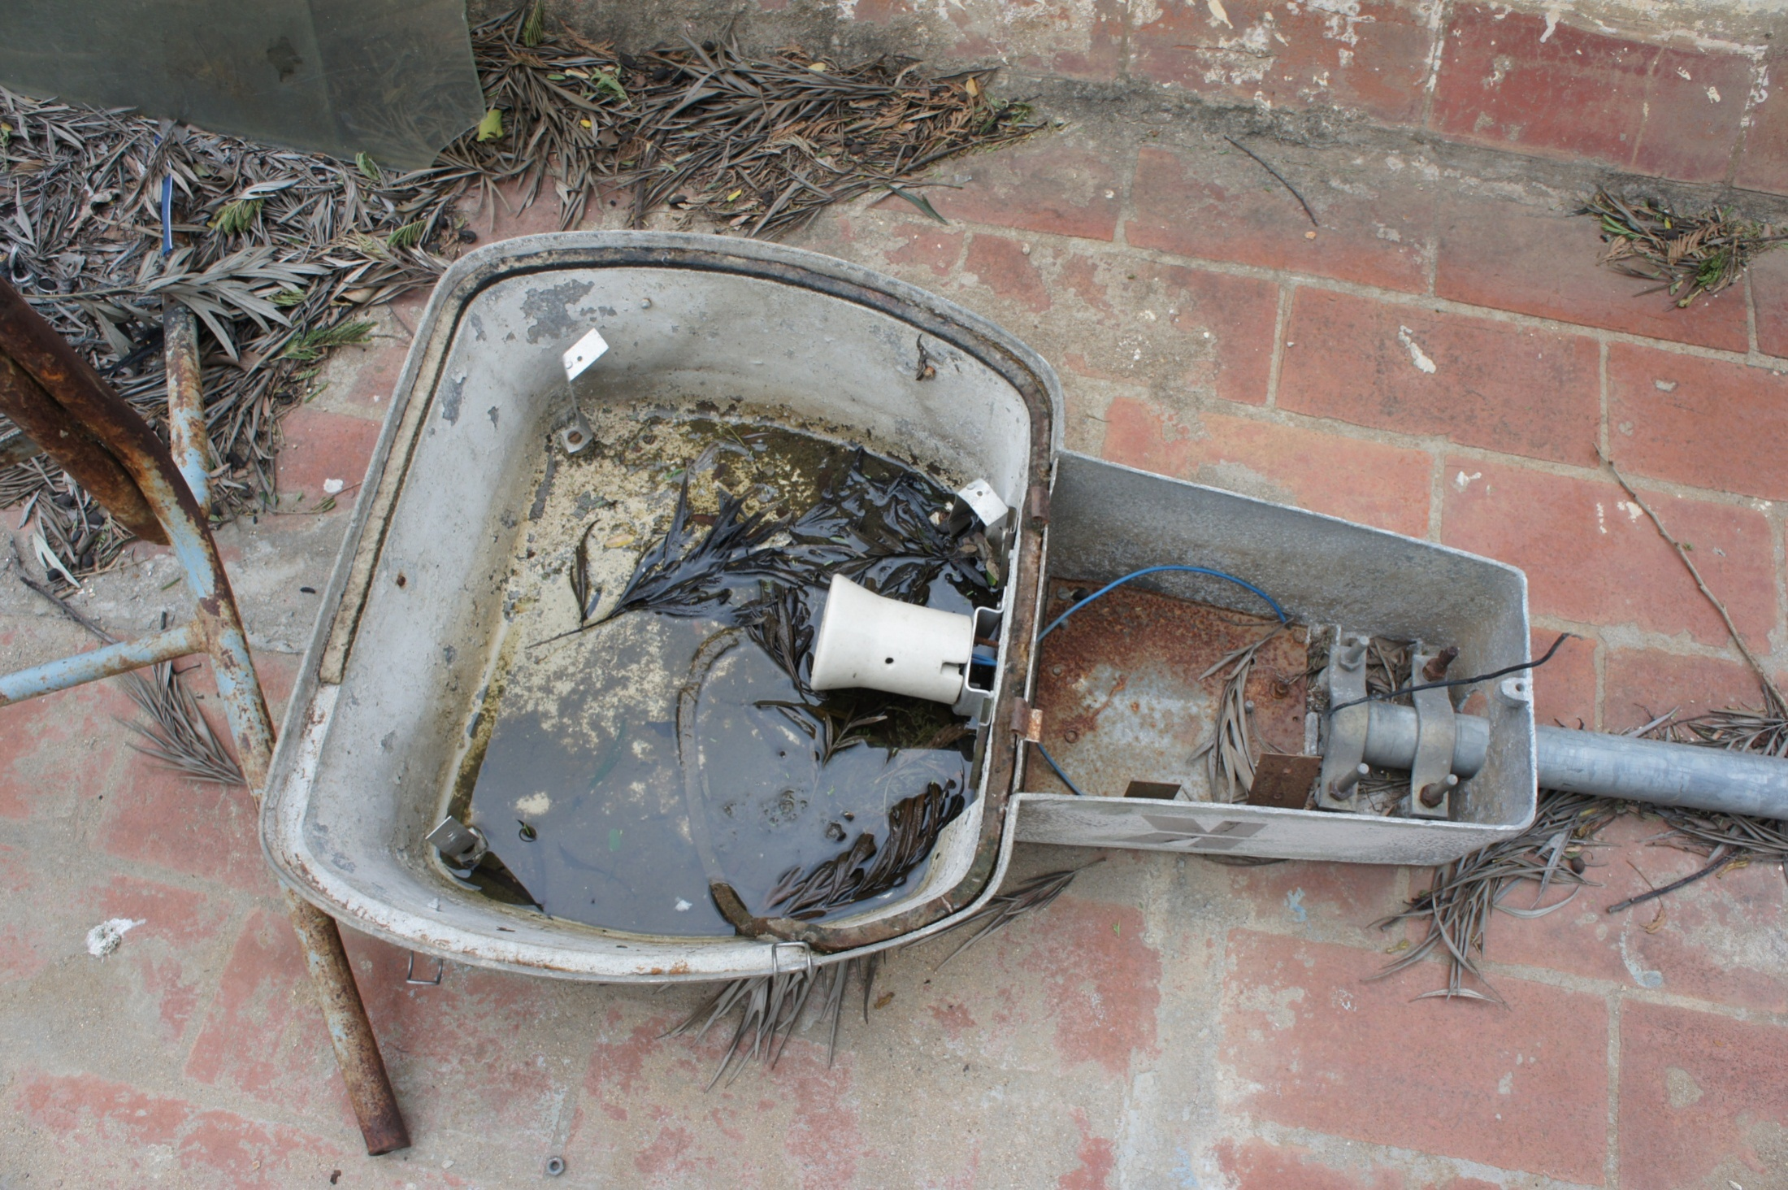

Slide 32
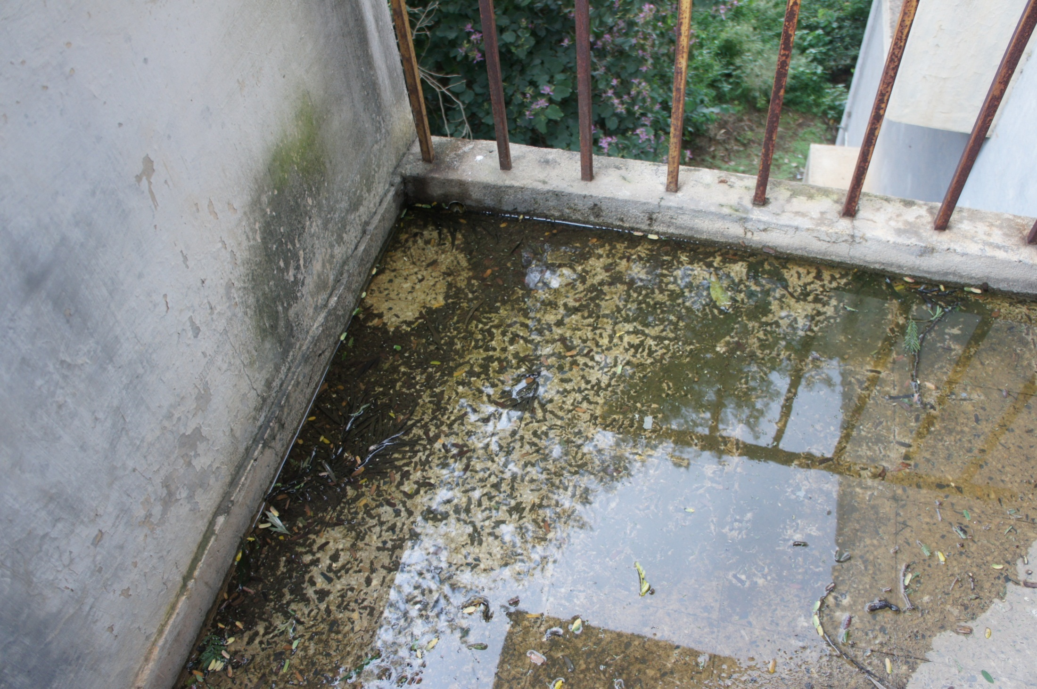

Slide 33
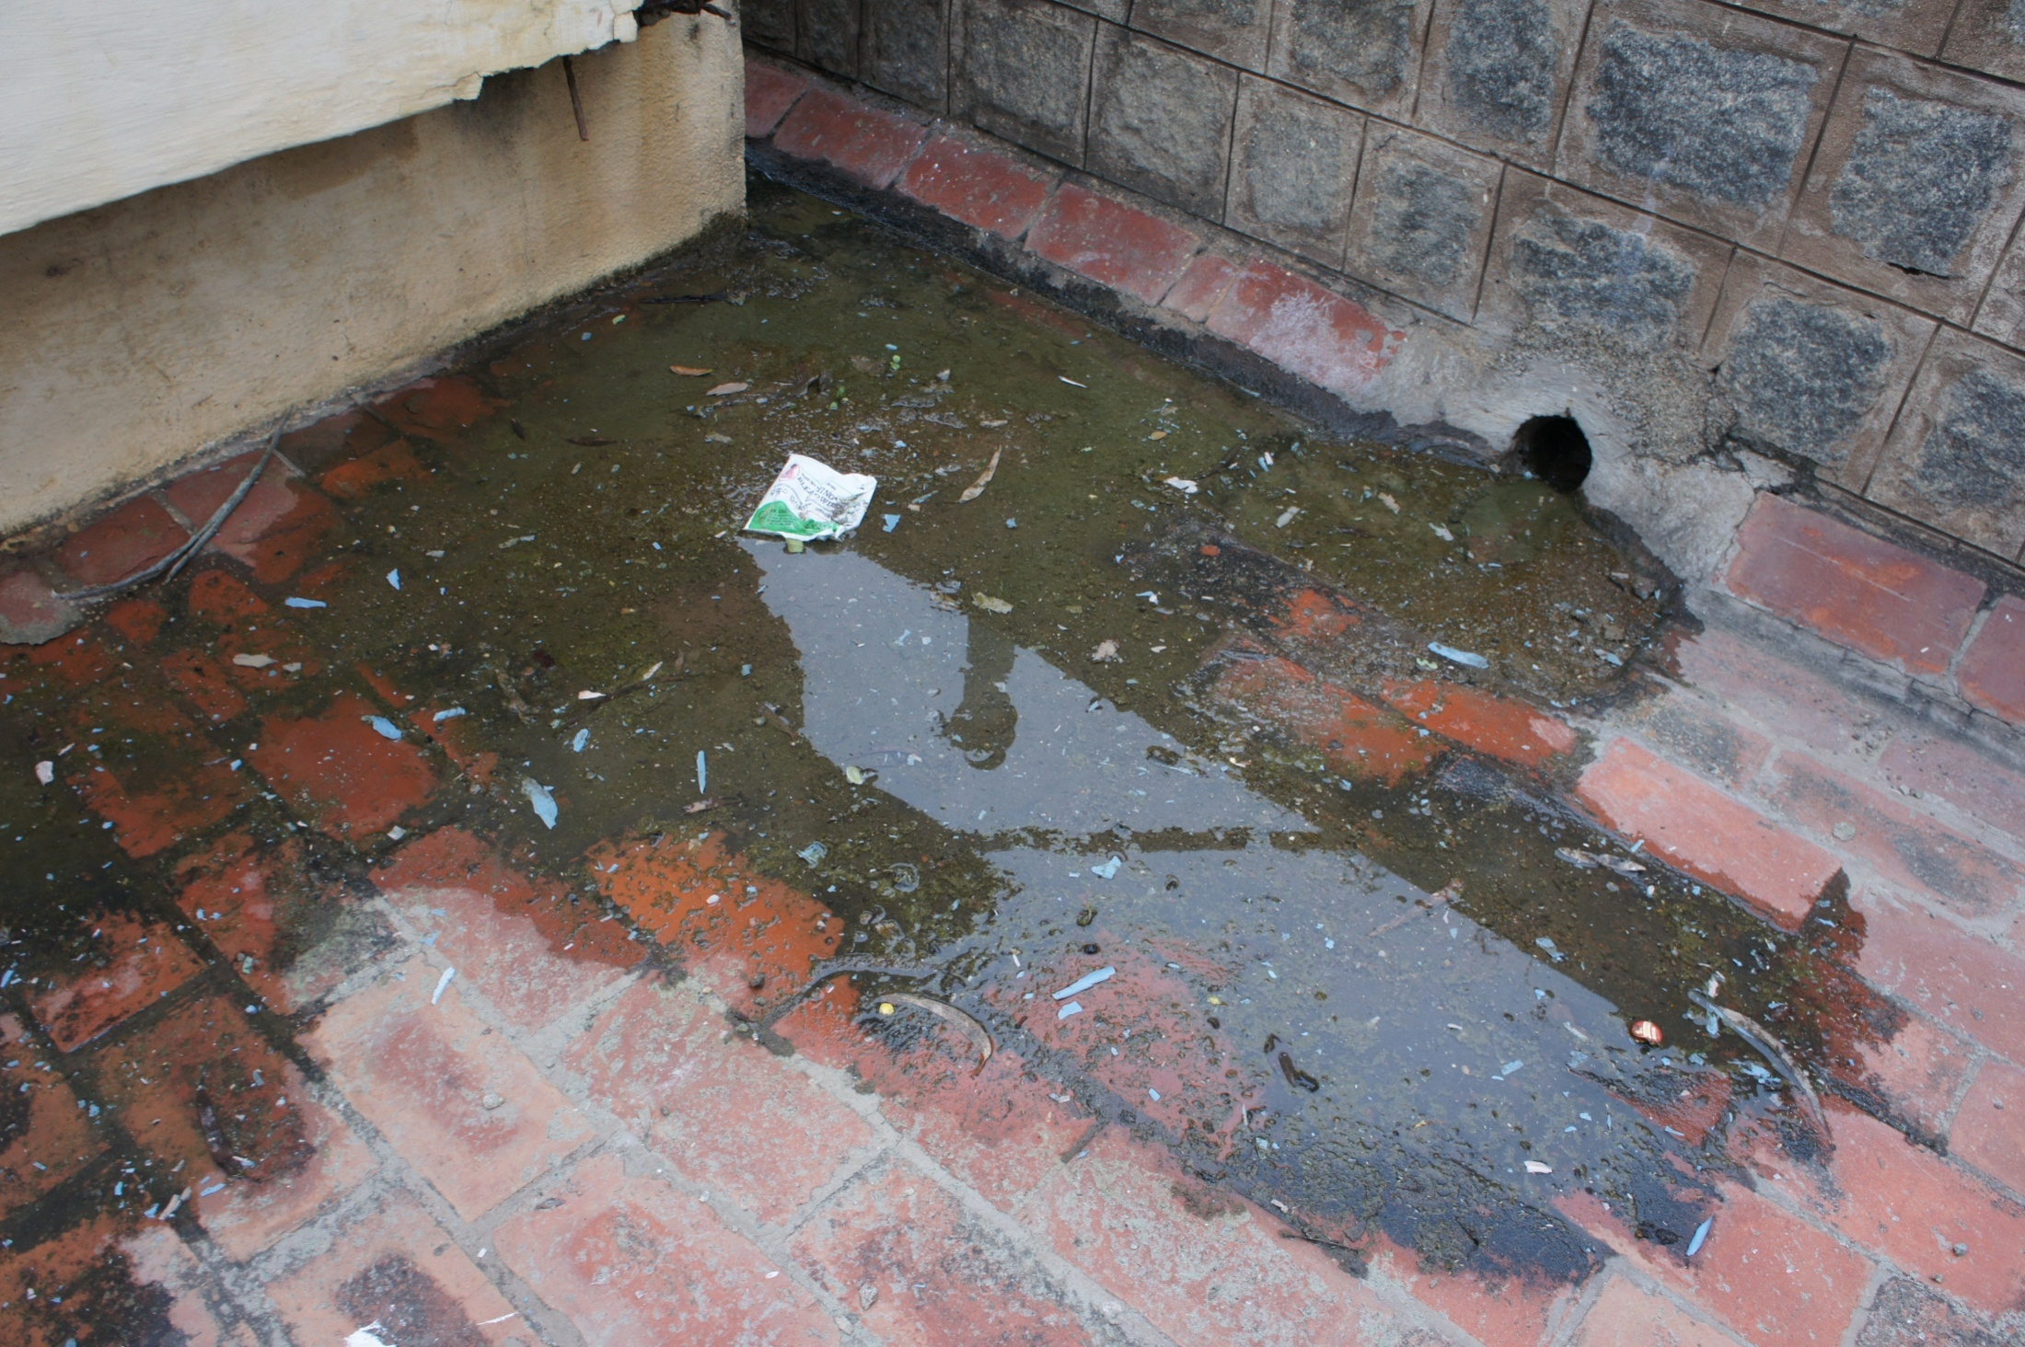

Slide 34
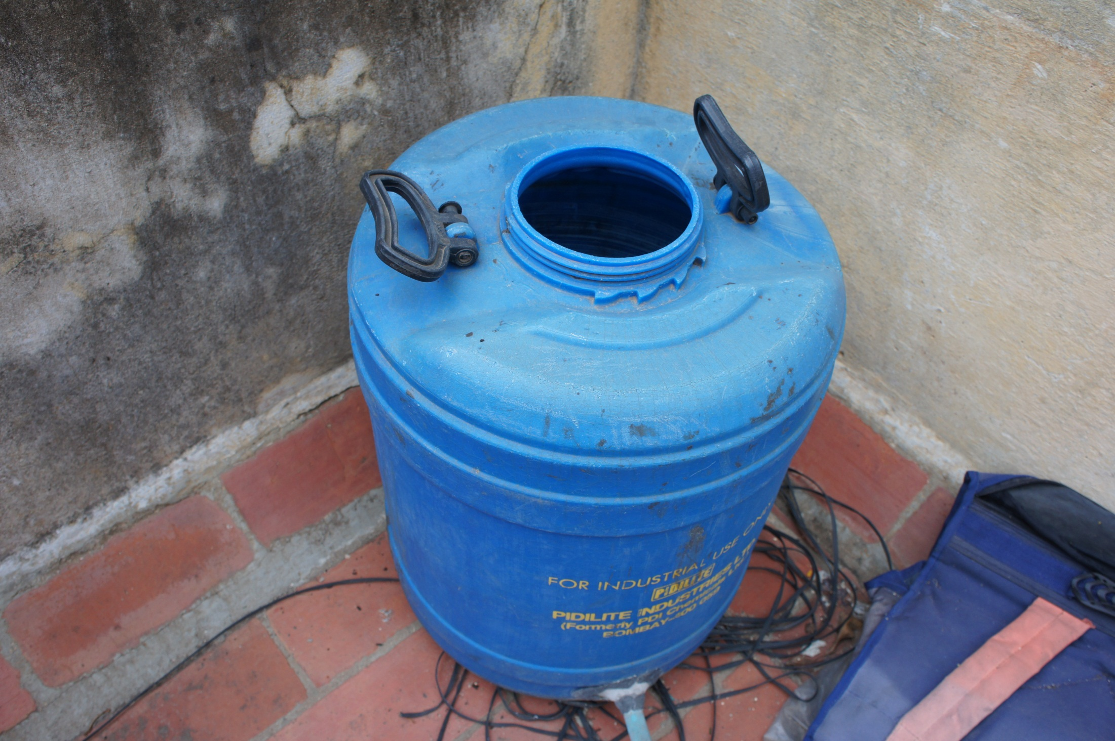

Slide 35
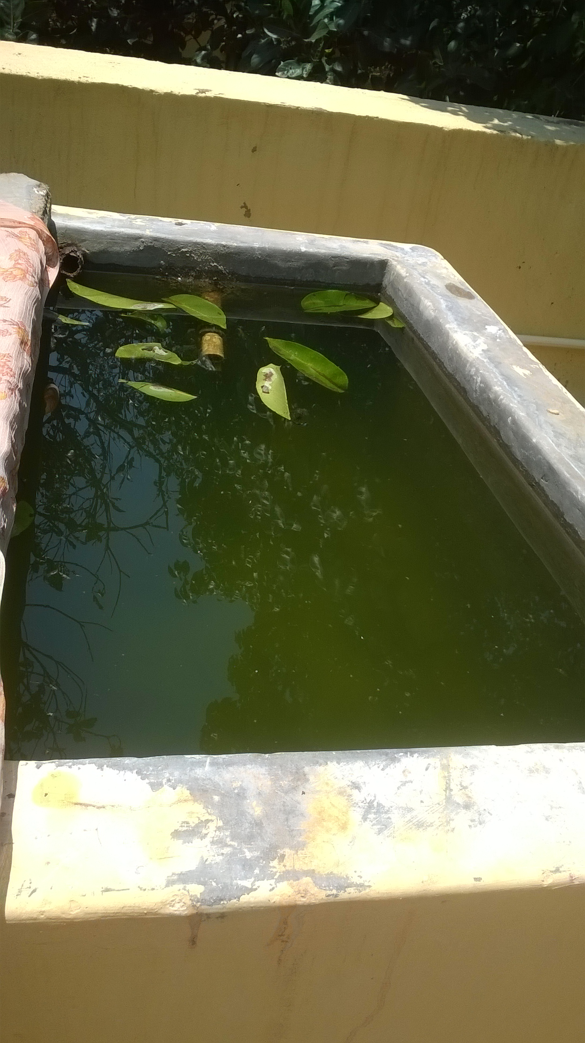

Slide 36
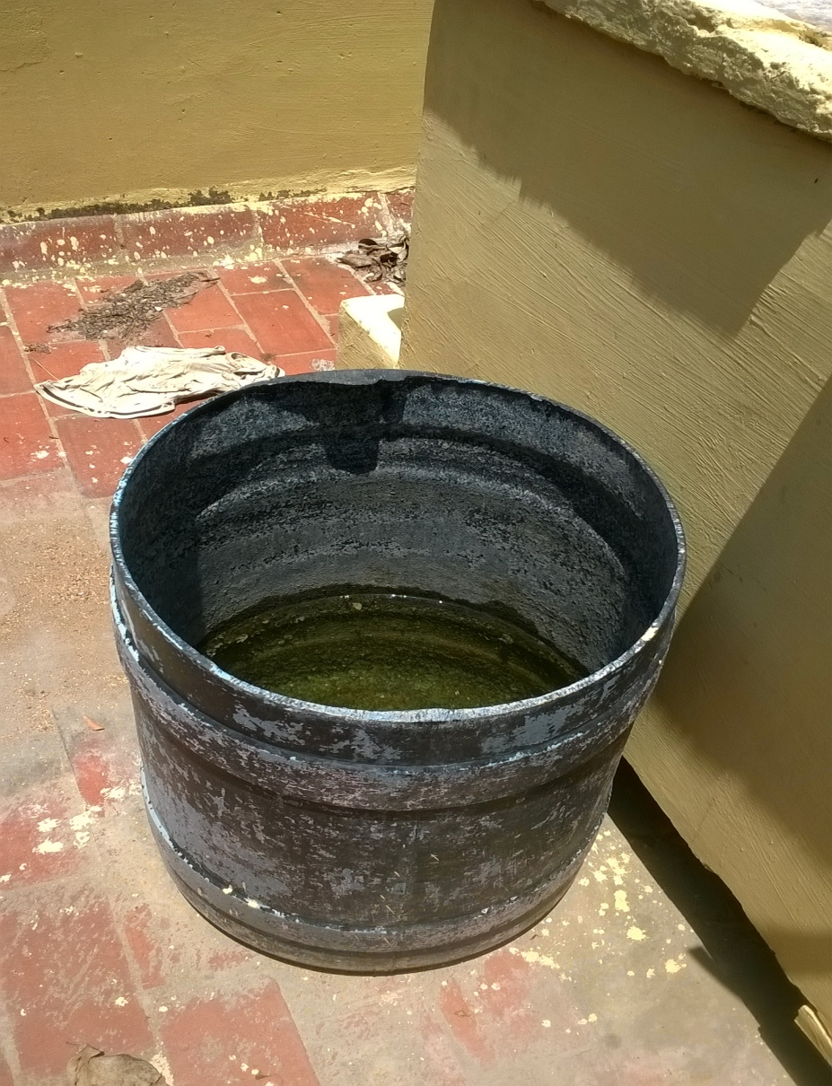

Slide 37
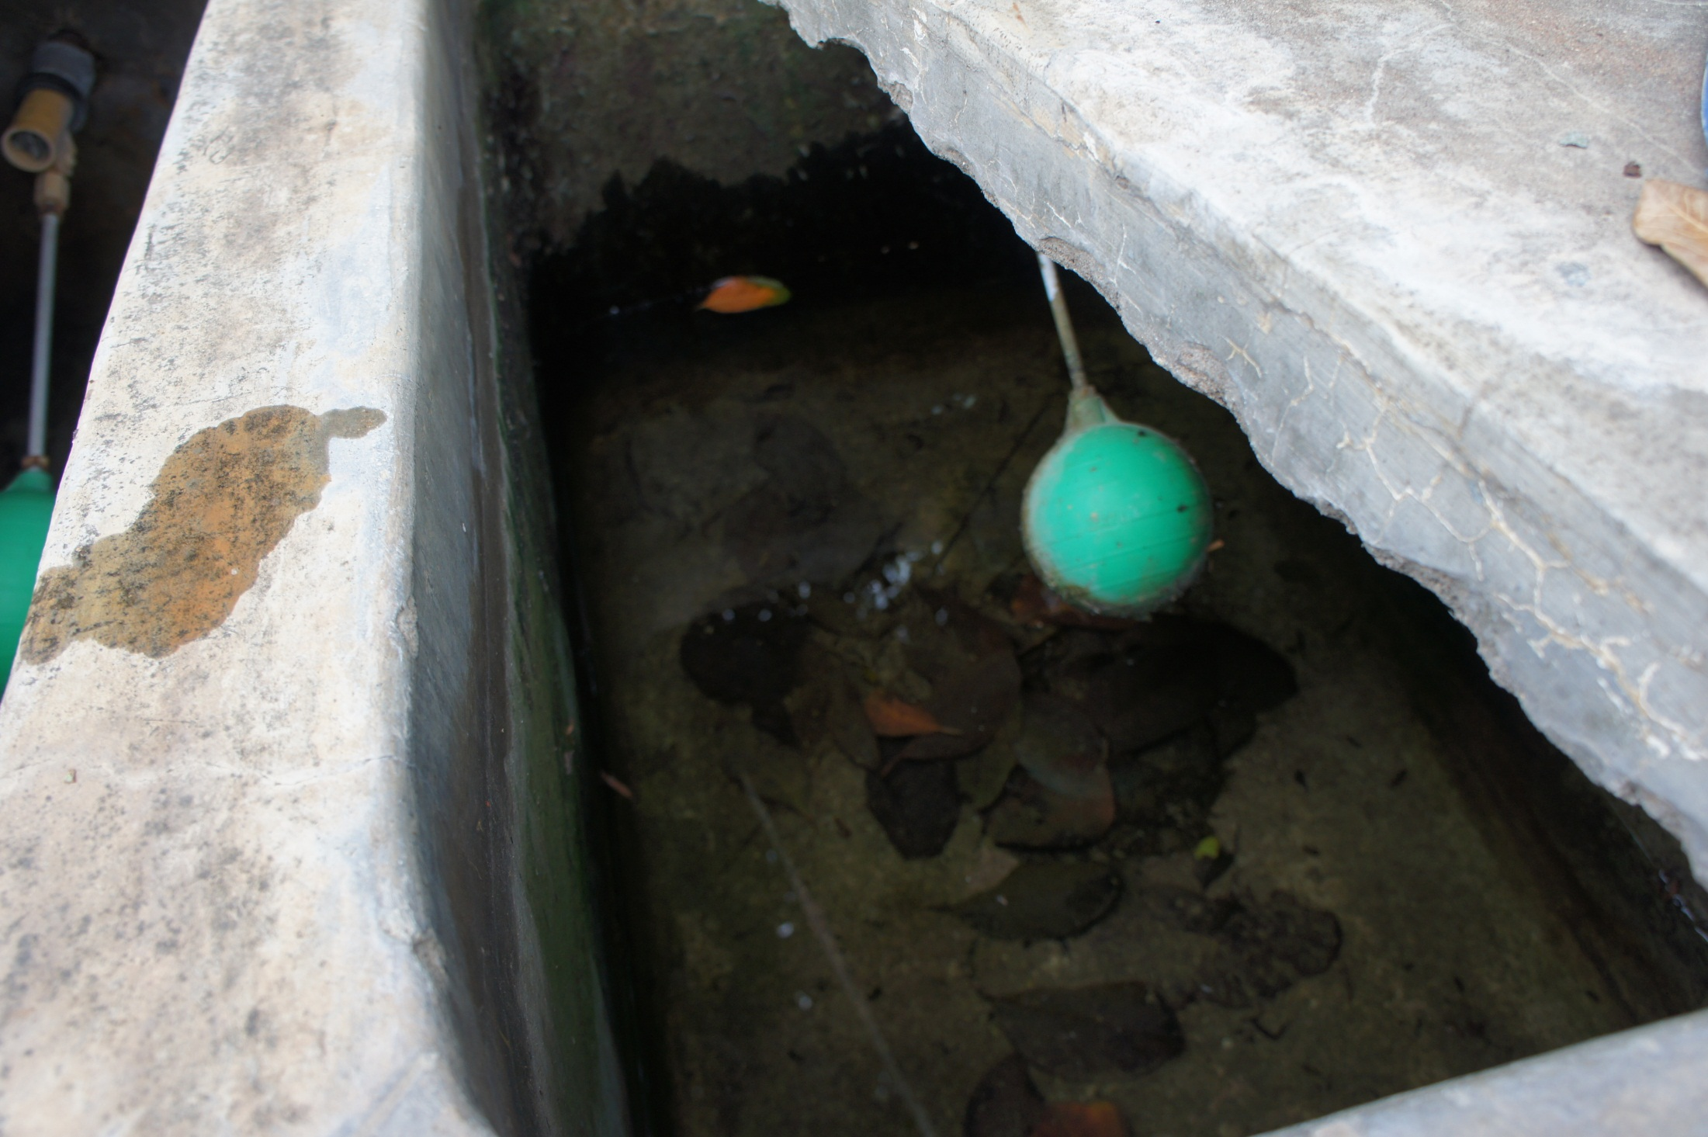

Slide 38
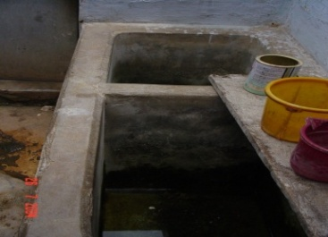
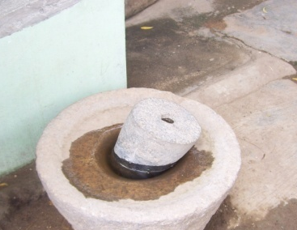

Slide 39
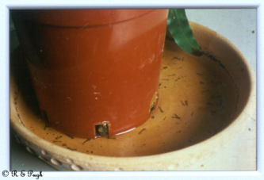

Slide 40
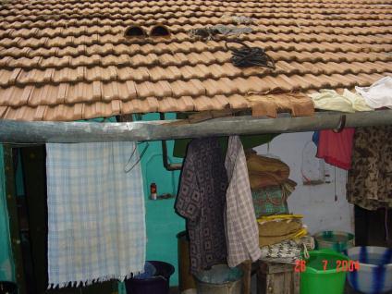
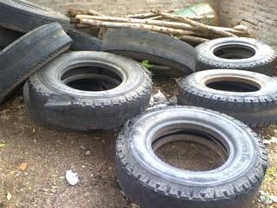
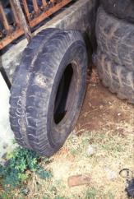
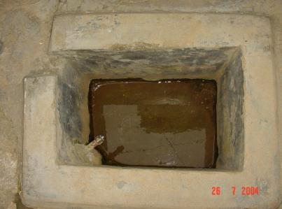
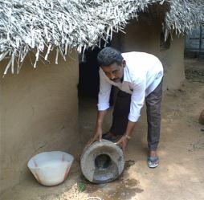

Slide 41
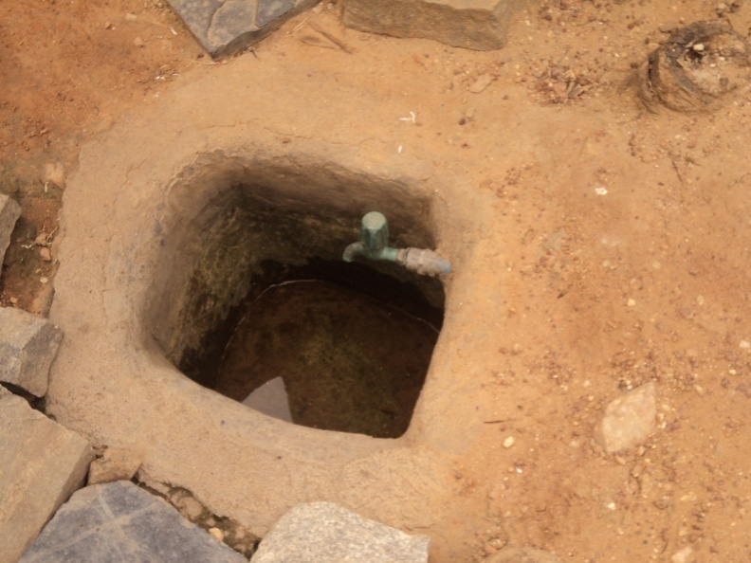
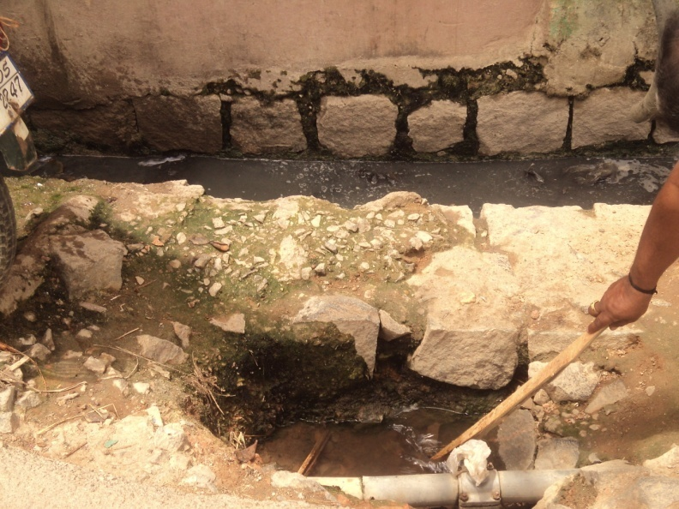
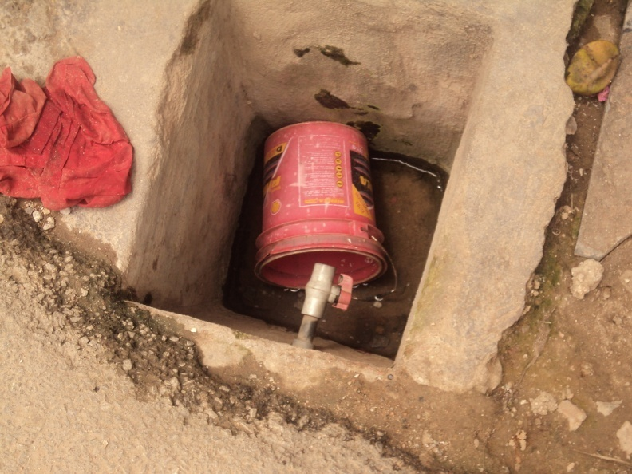
Tap Pits as Breeding sites

Slide 42
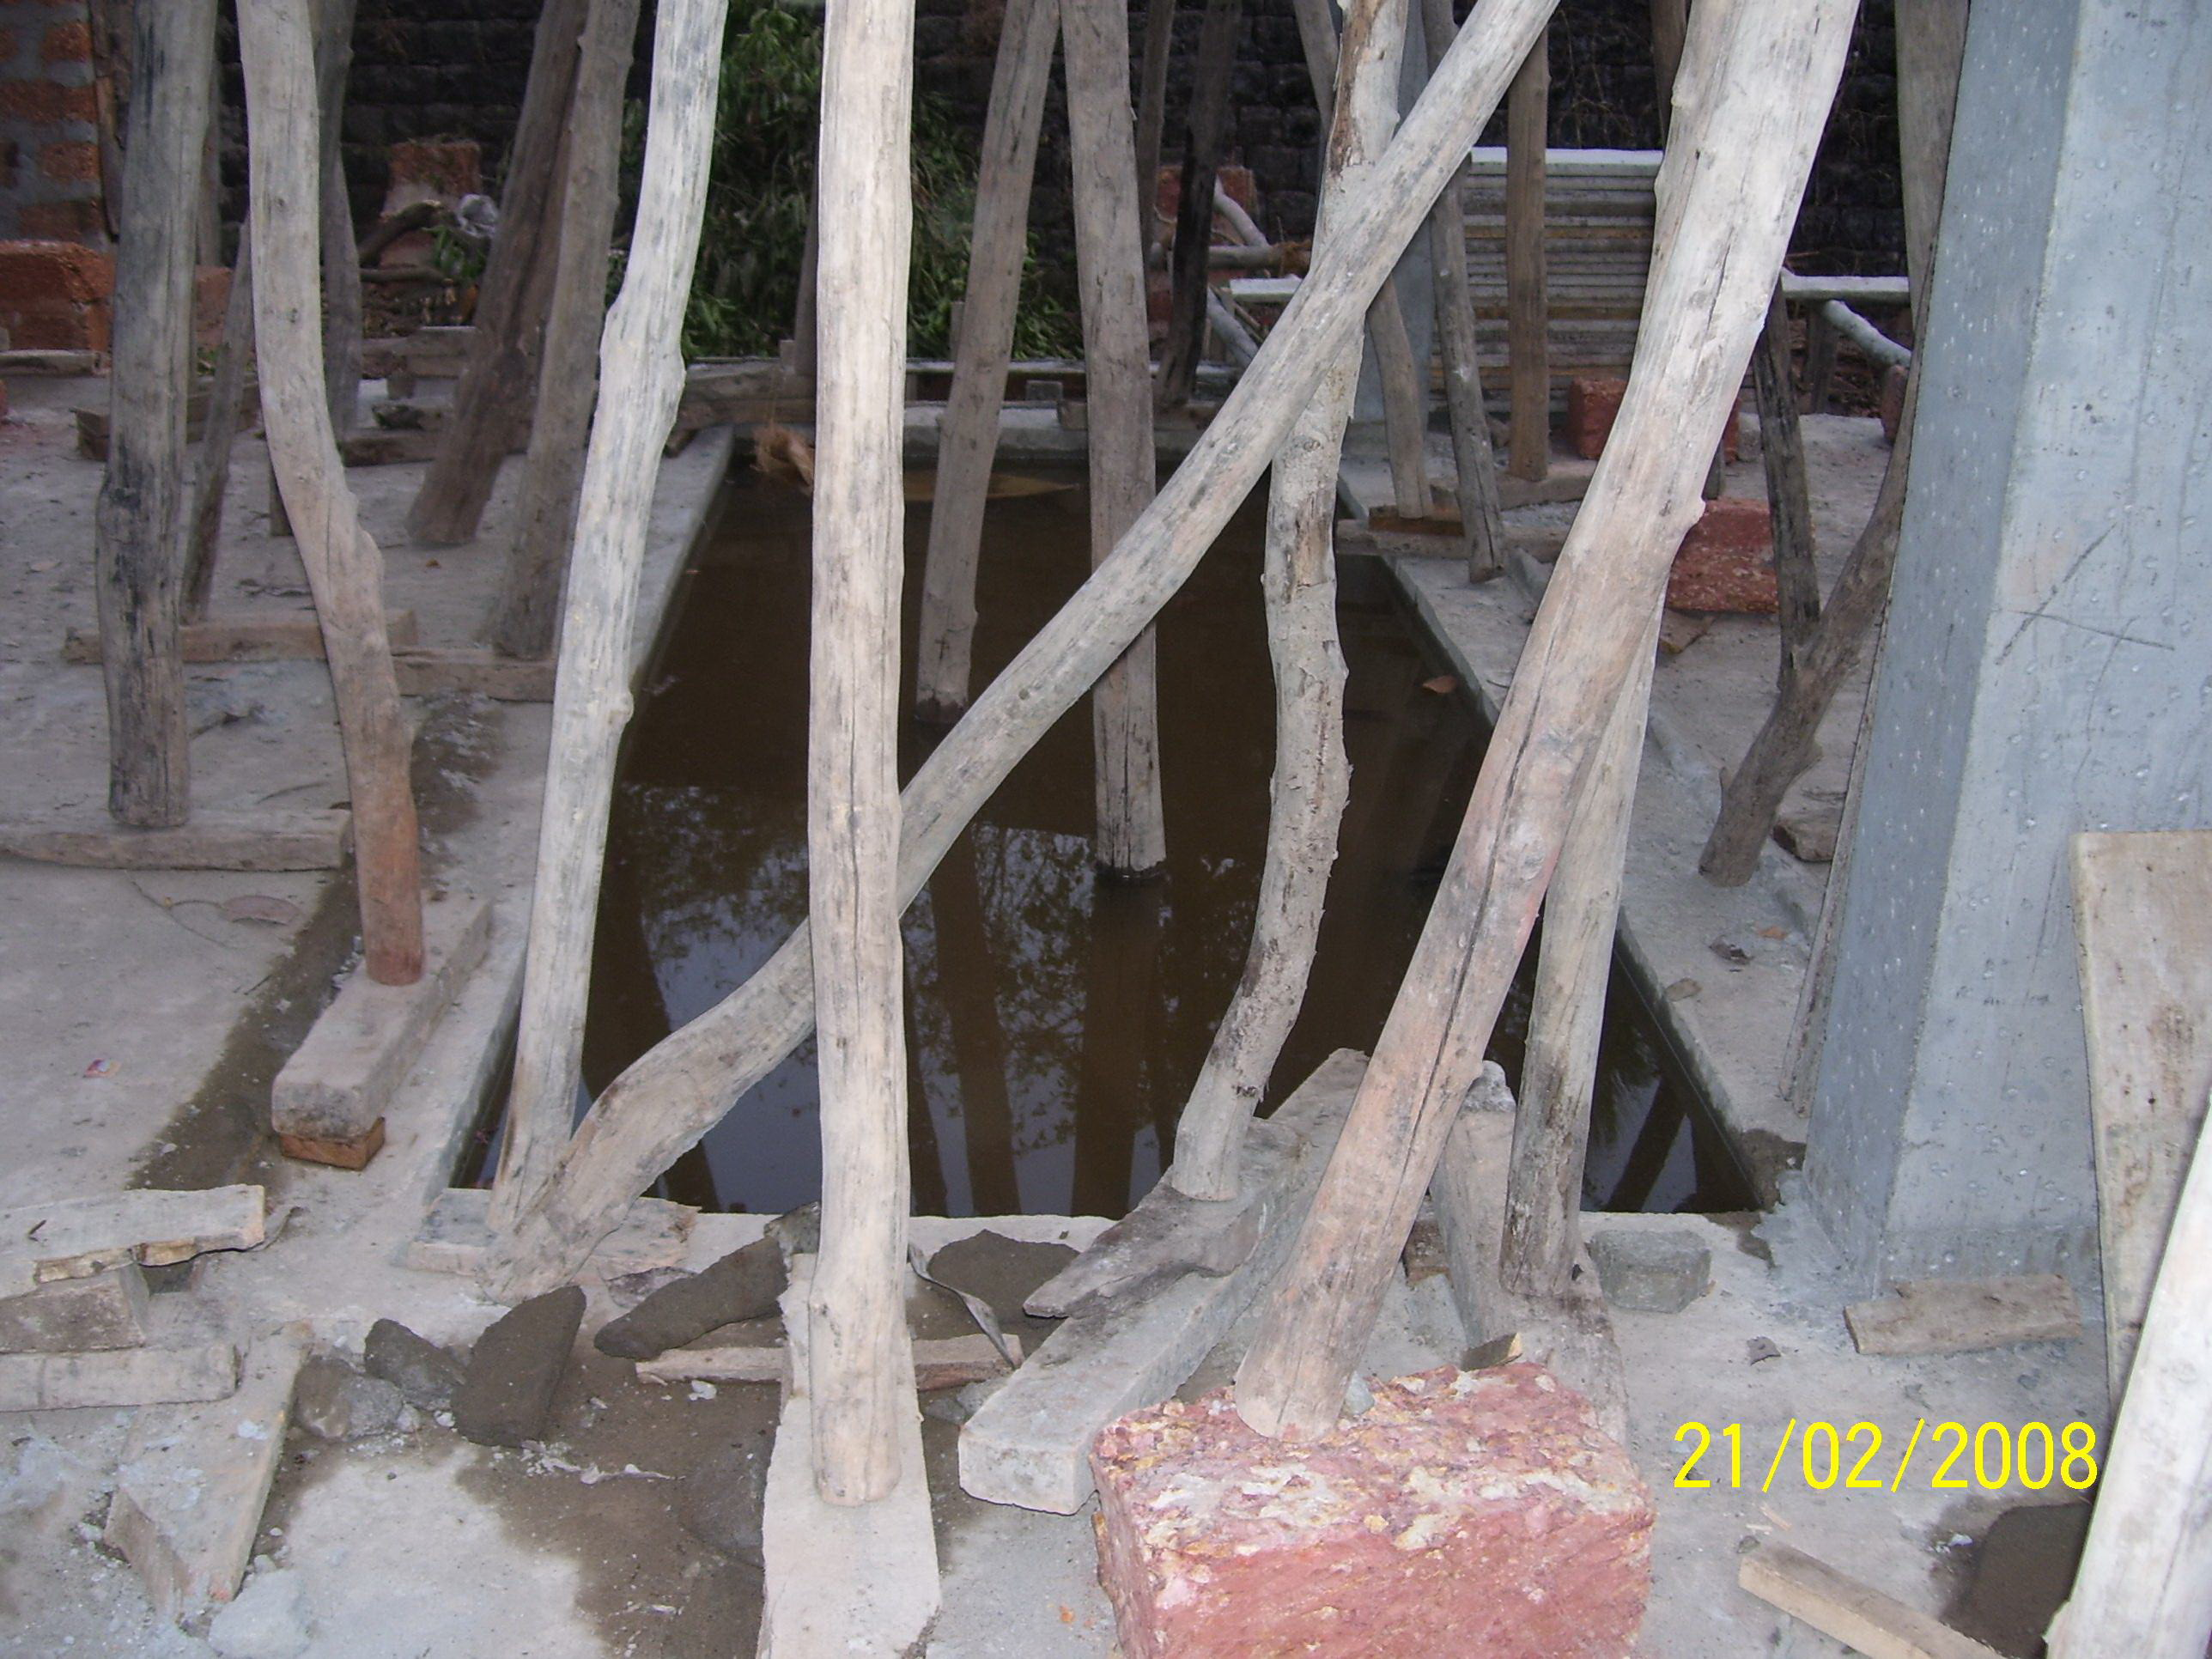

Slide 43
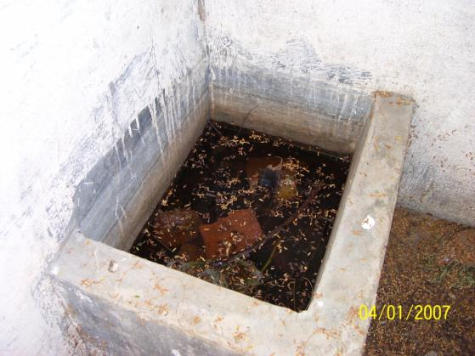

Slide 44
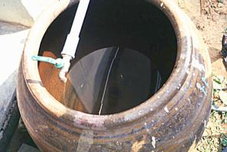
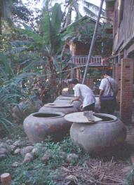
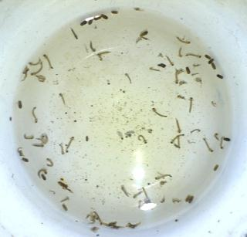
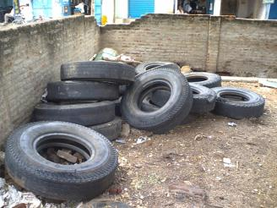
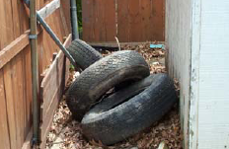
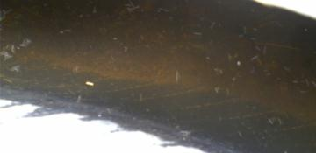
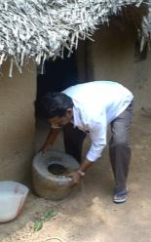
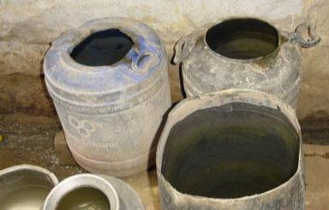

Slide 45
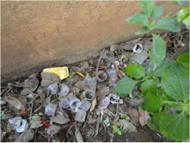

Slide 46
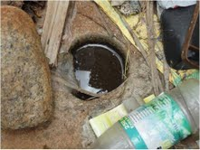

Slide 47
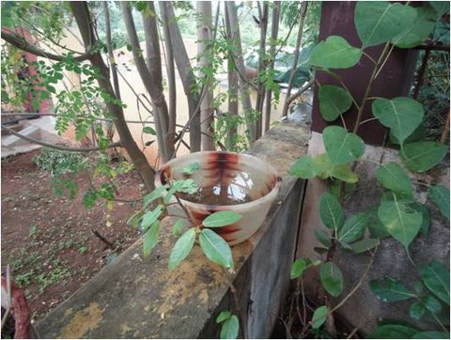

Slide 48
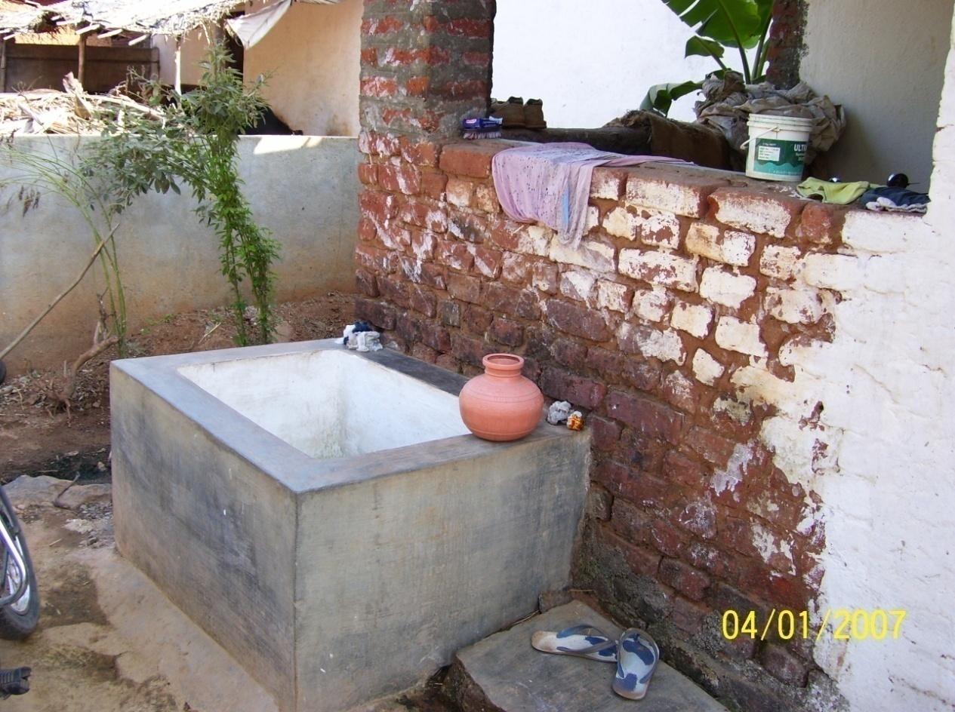

Slide 49
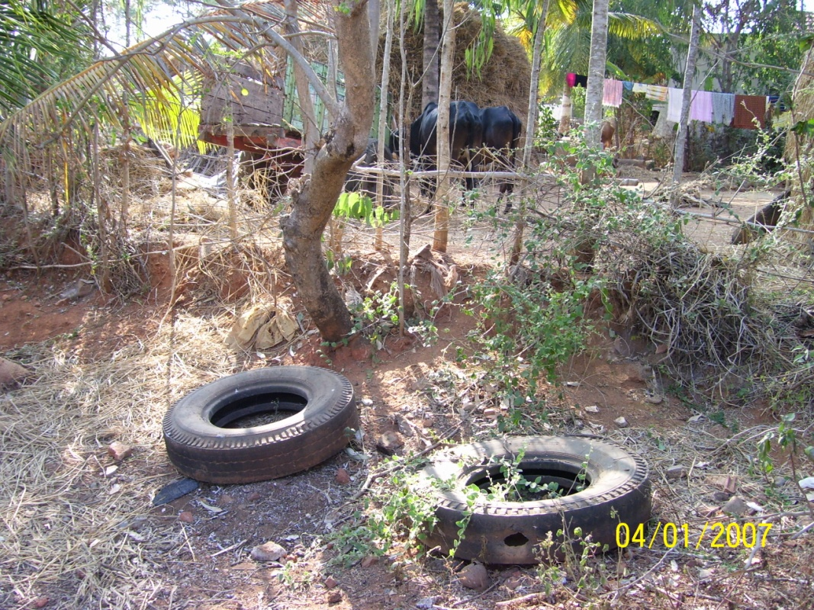

Slide 50
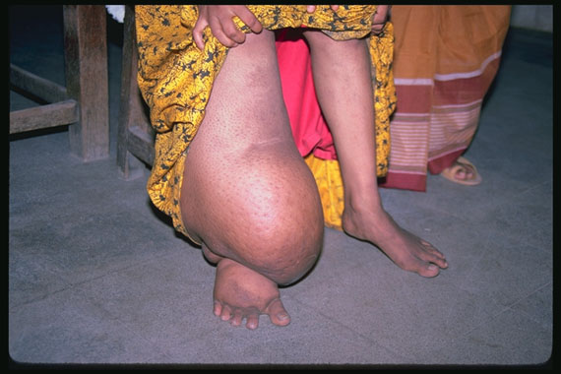
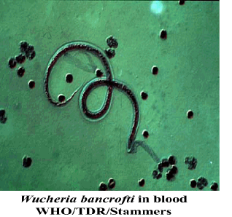
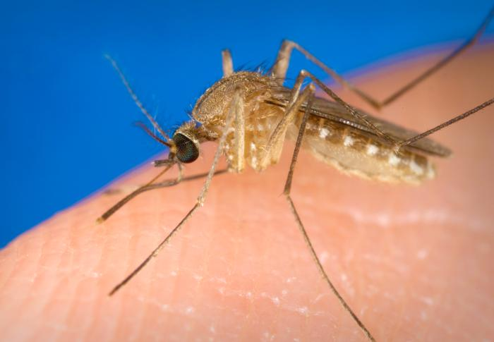
Lymphatic Filariasis

Slide 51
Distribution of LF in the world

Slide 52
Where?
99.4% of infections are caused by Wuchereria bancrofti and rest by Brugia malayi.
Vector: Culex quinquefasciatus.
Endemic in 255 districts in 21 states and UTs

Slide 53
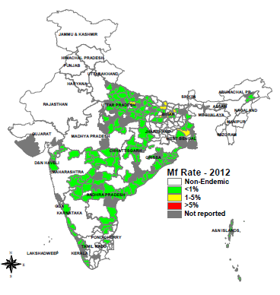
Filaria Map 2012

Slide 54
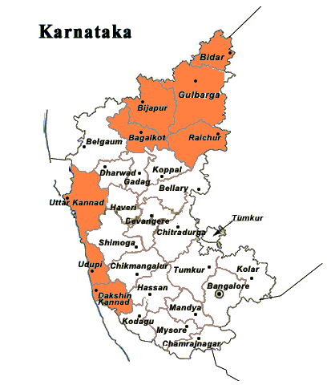
LF endemic Districts in Karnataka
Bidar
Bijapura
Bagalkot
Gulbarga
Yadgir
Raichur
D Kannada
Udupi
U Kannada

Slide 55
Strategy..

Slide 56
Progress..
10 rounds of Mass Drug administration completed
M.f. rate has shown satisfactory decline in Dakshina Kannada, Uttara Kannada and Udupi districts. Validation studies showing lack of antigenaemia in these three districts.
MDA stopped in these three districts
Lymhoedema management progressing

Slide 57
Trend of M.f rate in Karnataka

Slide 58
Issues..
Reduction of M.f rate is not up to the desired level in Bijapur, Bagalkot, Gulbarga, Raichur, Bidar and Yadgir districts.
Post MDA surveillance in Dakshina Kannada, Udupi and Uttara Kannada districts.

Slide 59
Thanks

